Slide 1
Building a Provenance-Aware Virtual Sensor System: A First Step towards an End-to-End Virtual Environmental Observatory
Yong Liu, PhD
Senior Research Scientist
yongliu@ncsa.illinois.edu
March 2nd, 2011

Slide 2
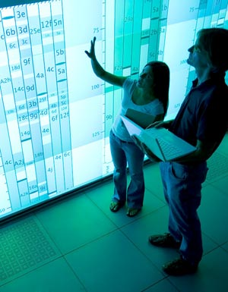
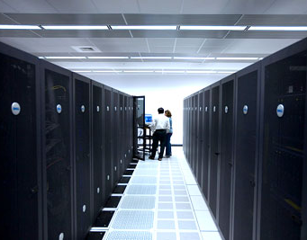
NCSA is…
World leader in providing scientists with the HPC and data-driven cyberinfrastructure needed to fuel scientific and engineering discoveries
Home to more than 300 computing experts and students who:
Create cyberenvironments and cybersecurity tools to support researchers and educators
Partner with industry and other research institutions across the globe
Birthplace of the first graphic web browser: Mosaic
Home to Blue Waters petascale computer, expected to be the most powerful computer for open scientific research when ready in the summer of 2011
Imaginations unbound

Slide 3
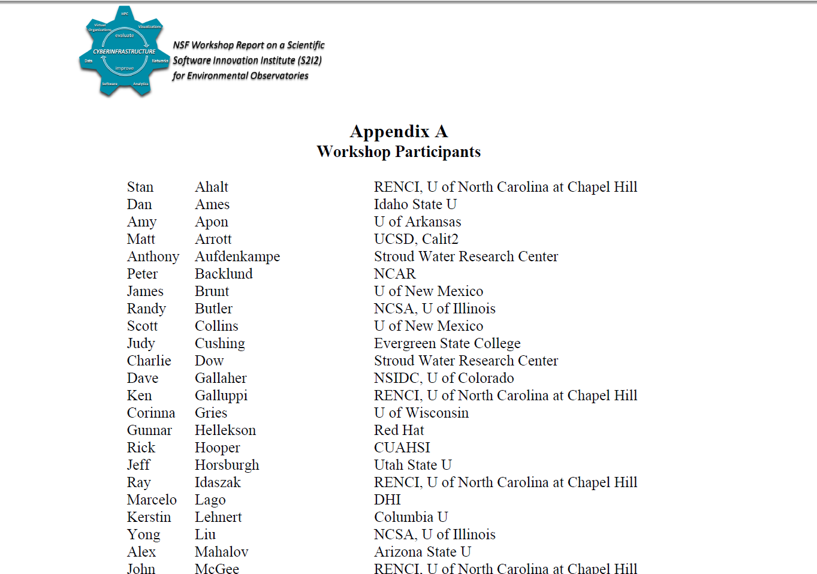







US NSF Workshop on Creating
Scientific Software Innovation Institutes for
Sustained Cyberinfrastructure Achievement and Excellence
Held on October 4-5, 2010
~50 participants from
7 environmental observatories programs
NSF program officers
Industry (Microsoft, RedHat, ESRI etc.)
Supercomputing centers (NCSA, RENCI
SDSC)
Major findings include:
Interoperability among heterogeneous
data/model/tools
Community participation
…… etc.
Notes:
3

Slide 4
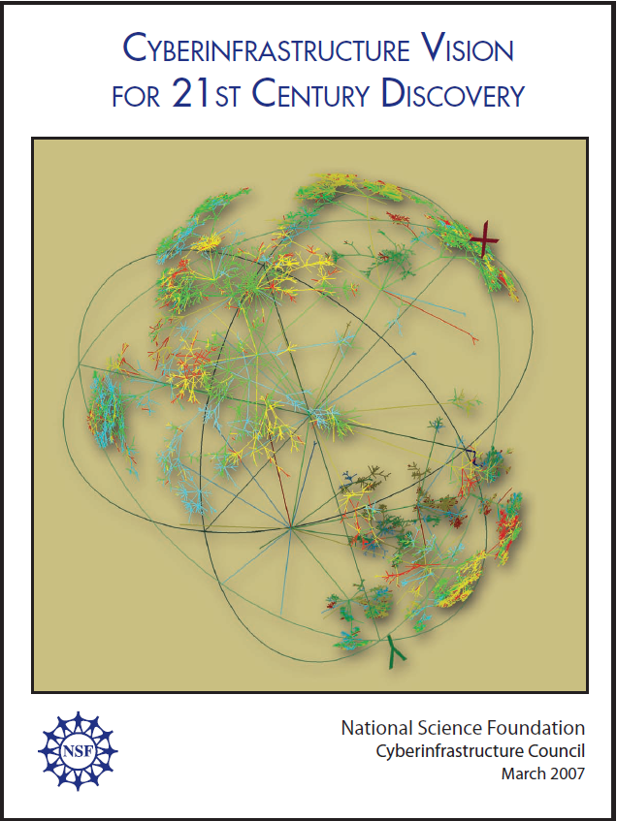
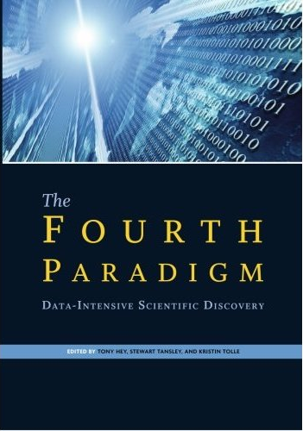
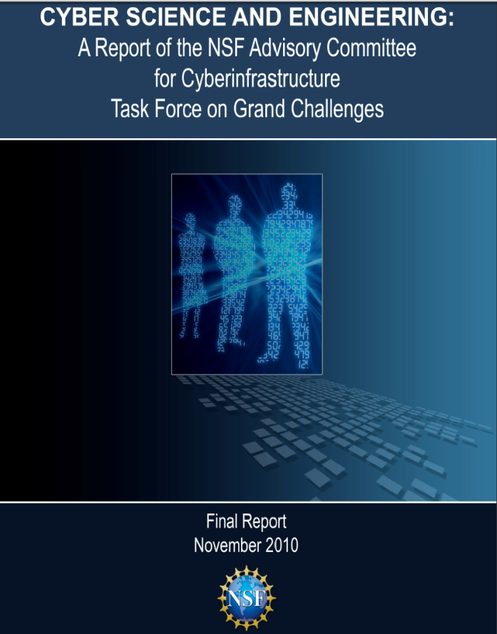
The Big Pictures
2007
2009
2010
cyberinfrastructure: computing systems, data, information resources, networking, digitally enabled-sensors, instruments, virtual organizations, and observatories, along with an interoperable suite of software services and tools
Data intensive
computing
Cyber Science and Engineering: computational and data-based
science and engineering enabled by CI

Slide 5
Motivation: Environmental Application and Decision Support System
Heterogeneous sensor sources
Mobile, participatory sensing/citizen sciences
Multi-agencies sources (USGS, EPA, State, and local……..)
Radar data (e.g.NEXRAD) and Remote Sensing data (GRACE)
Evolving needs for Environmental Observatories
Repurpose and reuse of sensor data and sharing
“Resolution Gap”
Spatial/temporal resolution are not available for specific research needs (e.g., real-time urban flooding and stormwater management, groundwater sustainability)
Real-Time Event-driven Feedback Control based on data and model: Cyber-Physical System for Decision Support
Harmonize data-driven model and physics-based model
Proposed Solution: An Integrated GeoS³Web: GeoWeb, Social Web, Sensor Web and Semantic Web

Slide 6
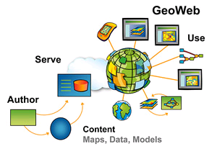
GeoWeb
http://www.esri.com/news/arcnews/summer08articles/gis-and-geoweb.html

Slide 7


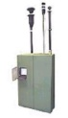
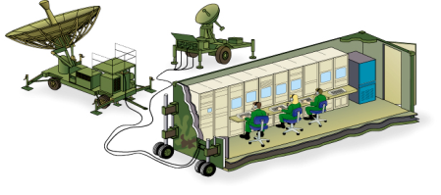

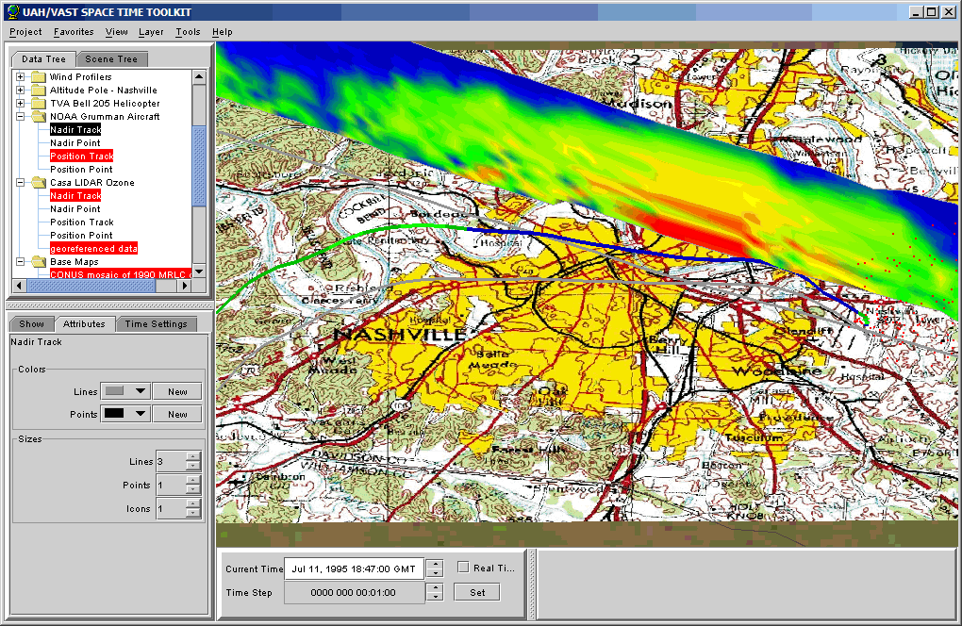
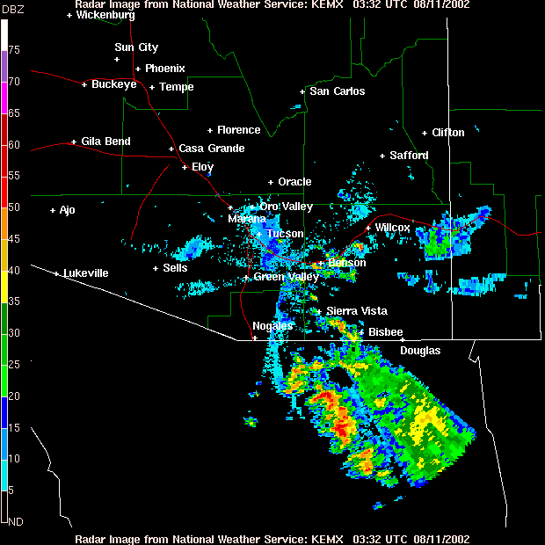
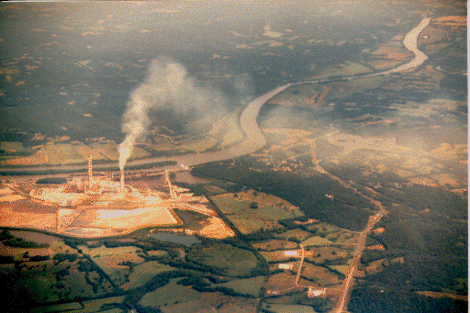
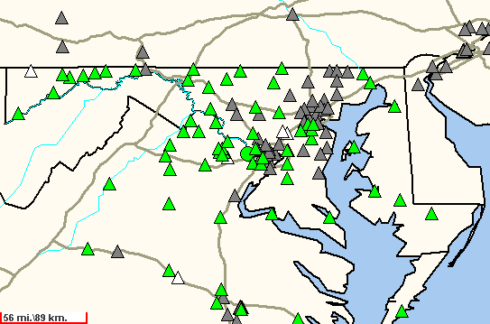
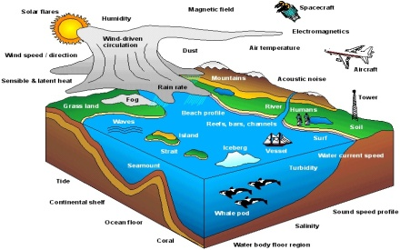
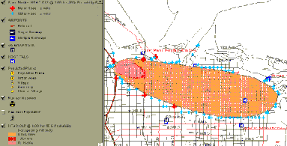
Sensor Web Enablement (SWE) Framework (Open Geospatial Consortium)
Providers—Heterogeneous sensor network
Users Decision Support
Tools
Airborne
Satellite
In-Situ monitors
Bio/Chem/Rad
Detectors
Sensor Web Enablement
Surveillance
sparse
disparate
mobile/in-situ
extensible
discovery
access
tasking
alert notification
web services and encodings based on
Open Standards
(OGC, ISO, OASIS, IEEE)
Models and Simulations
nested
national, regional, urban
adaptable
data assimilation
vendor neutral
extensive
- flexible
adaptable
Source: Botts, 2004

Slide 8

Social Web

Slide 9
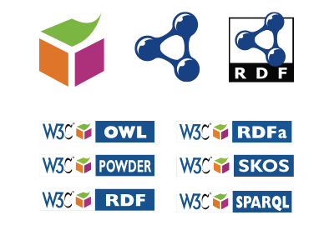
Semantic Web

Slide 10
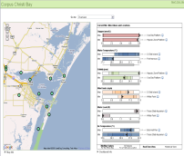
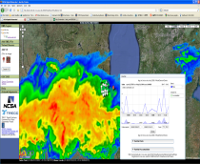
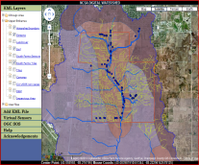
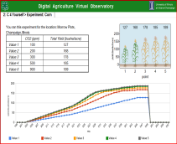
An Example Virtual Environmental Observatory Testbed: Illinois IACAT Data, Services, and Modeling
CMM5/CMAQ
Cloud Services
GreenHouseGasOffsetModel
THREW
DAYCENT
Adaptive Optimization
Visualization
Export (CSV)
PALMS
Modeling results and derived data products
Machine QA/QC
Virtual Sensors
Data Sources
~40 acres
Regional
Remote Sensing
IACAT motes, i.e.
nitrogen
Tile drain via datalogger
EBI sensors, camera
Survey sensors
Radar, satellite

Slide 11
Development of A Provenance-Aware Virtual Sensor System
An Example First-Step Research Prototype of a Virtual Environmental Observatory
Specifically addressing two challenges
Resolution Gap:
“User-generated Virtual Sensors”
Community Validation:
“Provenance-aware Virtual Sensors”

Slide 12
Challenges
Challenge 1: Lower the Barrier to Resolve “Data Resolution Gap” Problem
Spatial, temporal, thematic differences between raw sensor streams and user-desired data resolution for modeling or decision support needs
Enable “User-generated Virtual Sensors”
Challenge 2: Promoting Community Participation and Sharing by Providing Provenance-Aware “virtual sensors”
Provenance enables users to understand, verify, reproduce the derived data products
Interoperability and Integration of Provenance information in heterogeneous sensor webs are difficult

Slide 13
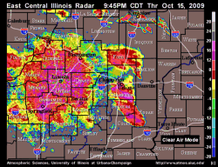
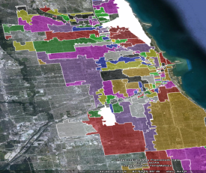
Overview: Virtual Sensors as New Sensor Streams
Definition: a product of thematic, spatial, and/or temporal transformation and aggregation of one or multiple raw sensor measurement(s)
E.g.: polygon-based virtual rainfall sensor: real-time NEXRAD reflectivity is transformed into rainfall rate value (thematic transformation) for a given polygon area using spatial interpolation
Results are then re-published as new “live” persistent “virtual” sensor streams with provenance information in near-real-time
E.g.:the polygon-based virtual rainfall sensor is re-published as a new color-coded KML data stream

Slide 14
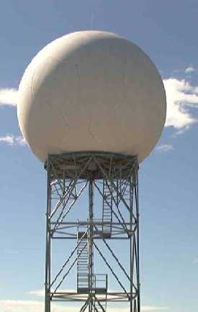
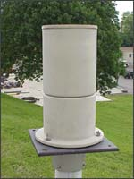
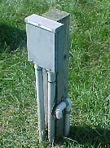
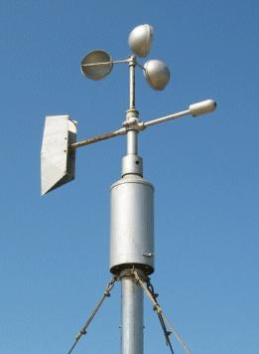

Characteristics of Virtual Sensors
Error Correction
and QA/QC Filtering
Spatiotemporal Coordinate transformations
Virtual Sensors
Spatiotemporal Measurements Aggregation transformations
Heterogeneous
Environmental Sensor Networks
Point-, Polygon-, Grid-based Virtual Sensor
Ready for downstream physics-based modeling needs
(simulation and/or optimal control etc.)
Can be created entirely in the cyber-world
Implemented as Parametric workflows
with some deployment parameters

Slide 15
Loosely Coupled, Layered Prototype Architecture
Web User Interface
Web 2.0 AJAX Map-centric
Data and Workflow Service
Virtual Sensor Abstraction and Management Service
NCSA Streaming Data Service (fetching, indexing, etc.)
Cyberintegrator Workflow Service (with model integration)
Tupelo middleware (Content and Provenance Management)
Virtual Machine Hosting (NCSA Private Clouds)
Remote Sensor Stores
E.g.: NEXRAD Level II data from National Weather Service (NWS)’s Unidata LDM distribution system

Slide 16
Challenge 1: Lower the Barrier to Resolve “Data Resolution Gap” Problem

Slide 17
Management of Derived Virtual Sensor Metadata
A Virtual Sensor is more than just a new time-series data stream.
TemporalFrequency
GIS Layer
hasTemporalInterval
belongsToLayer
derivedFrom
hasDataStream
DataStream
Virtual Sensor
hasLocation
SpatialThing
hasThematicInterest
isA
isA
ThematicInterest
e.g. rainfall rate, rain fall accumulation
Point
Polygon
SWE2009

Slide 18
Use Case 1: Creating a Virtual Rain Gage?
Need near-real-time measurements of 30-minute rainfall accumulations in specific locations with WGS-84 latitude/longitude coordinates (X,Y)
There are no rain gauges in or near the locations
The Next Generation Radar (NEXRAD) system provides near real-time spatial measurements of radar reflectivity, which are correlated with rainfall.
How can we use NEXRAD to give us rainfall virtual sensor?
Needs spatial, temporal and thematic transformation!

Slide 19
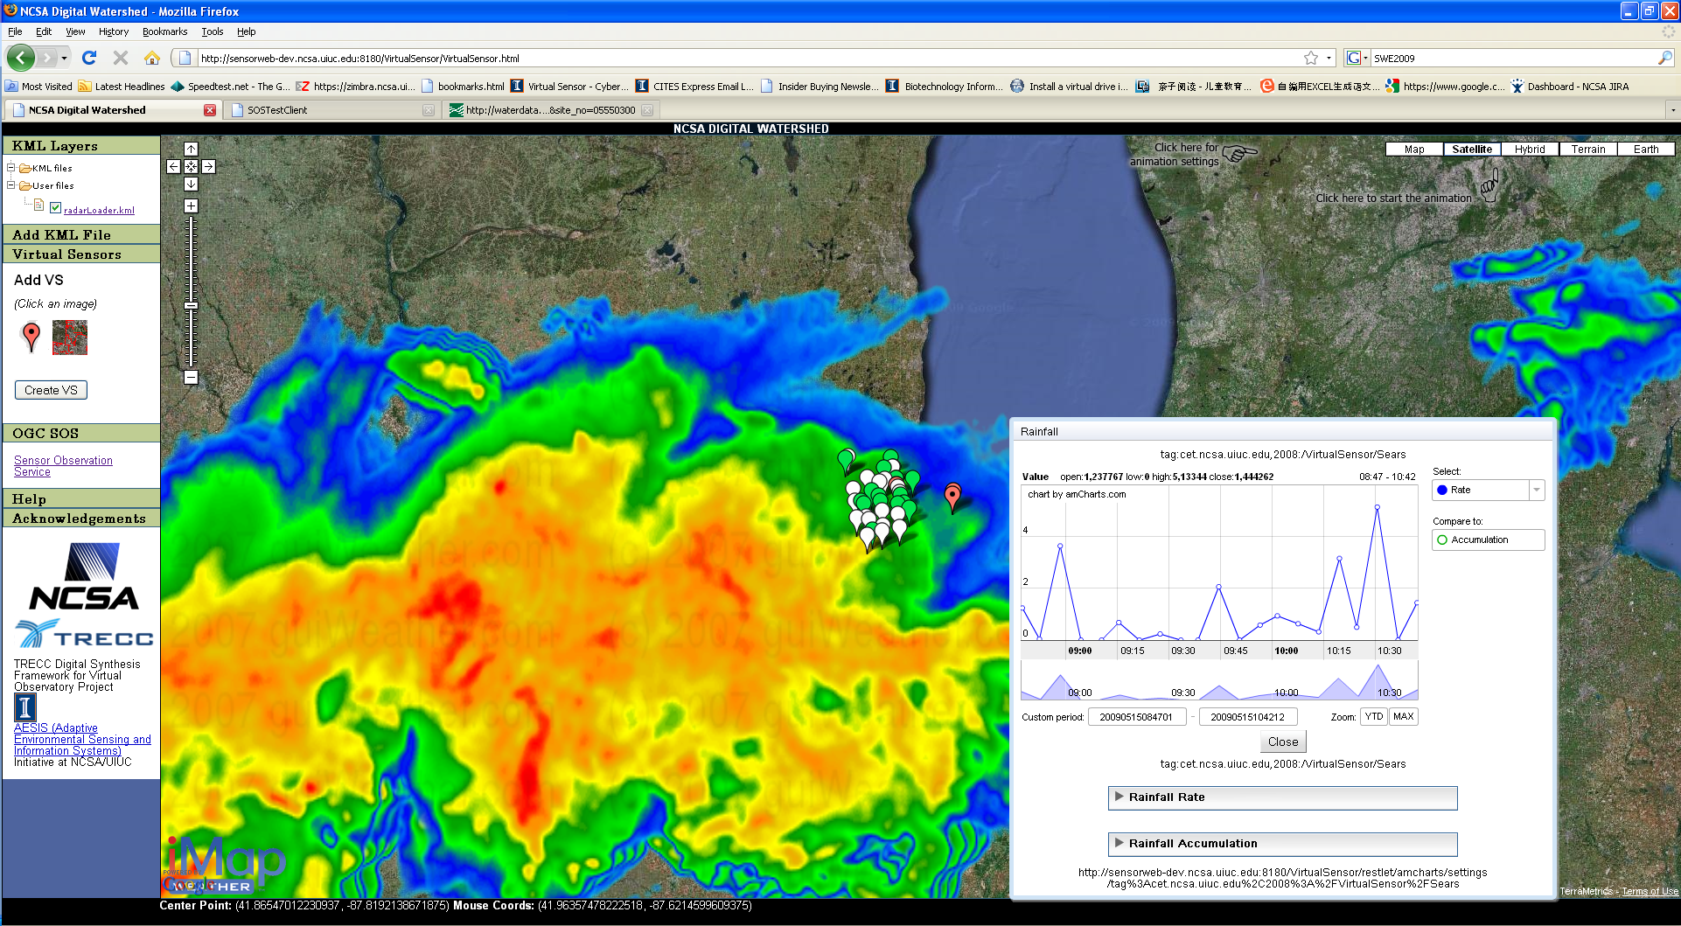
Real Time Point-based Virtual Rainfall Sensor ACM GIS 08

Slide 20
Use Case 2: Urban Flooding
Spatiotemporal distribution of intense rainfall significantly impacts the triggering and behavior of urban flooding
However, no general purpose decision tools yet exist for deriving rainfall data and rendering them in real-time at the resolution of urban hydrologic units (i.e.: sewershed) used for analyzing urban flooding.
Goal: Understand real-time spatiotemporal rainfall variability using NEXRAD data in an urban sewershed

Slide 21
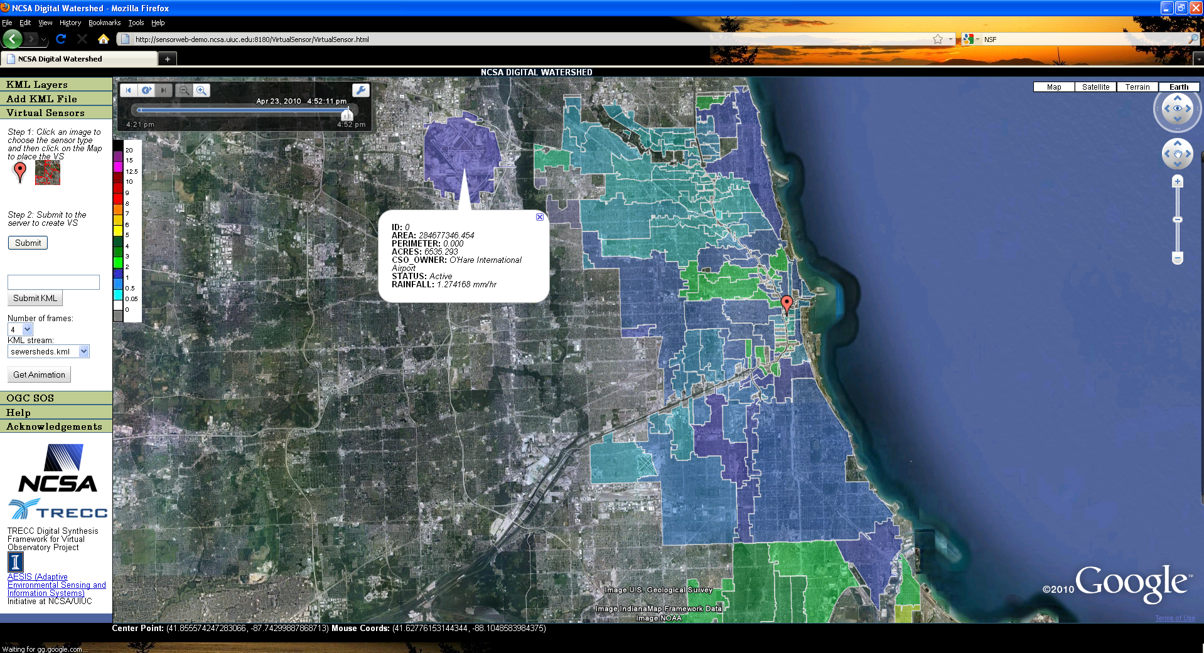
Real Time Polygon-based Virtual Rainfall Sensors on the Web
ACM GIS 09

Slide 22
Virtual Sensor Management Functionality
Registers/de-registers virtual sensors metadata in the Tupelo-managed data/meta-data registry
Dynamically triggers back-end workflow execution through the workflow RESTful web service to produce new streaming data
Dynamically generates input files needed for the workflow execution
For point-based Virtual Sensor: provides a list of virtual sensor coordinates and unique IDs or
For polygon-based Virtual Sensora set of polygons extracted from an input KML file provided by the user

Slide 23
NCSA Streaming Data Toolkit
Manage time-series data
Has implementations/wrappers for stream managers such as DataTurbine and ActiveMQ JMS
Supports fetching, publishing, indexing and query
Window query; Point query; Newest, oldest; Previous, next
Publishing results in either CSV, XML, JSON or Open Geospatial Consortium (OGC) O&M format
Enables the workflow tool to retrieve latest x frames for stream-aware computation and aggregation
Can trigger workflow execution based on newly arrived sensor data event

Slide 24
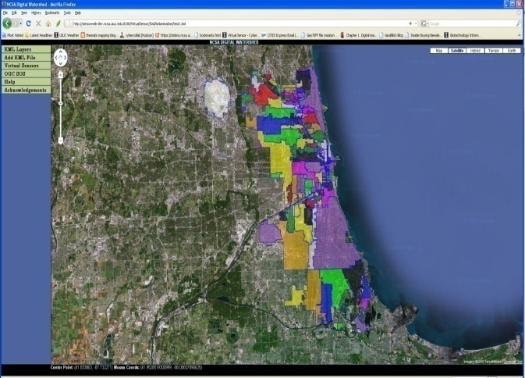
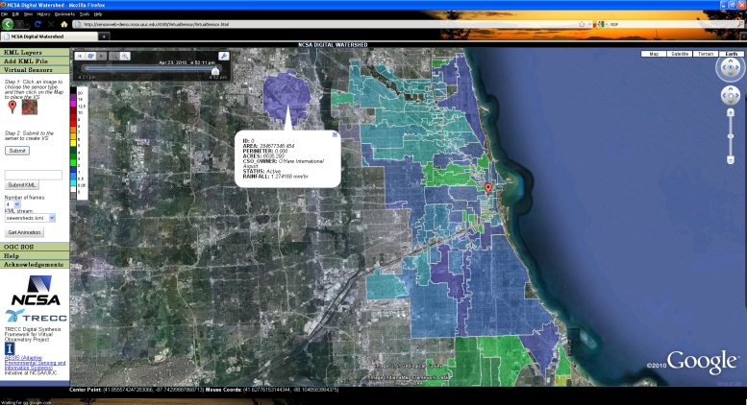
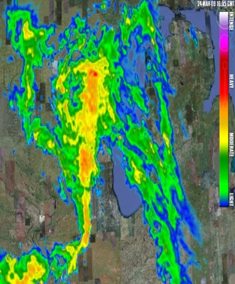
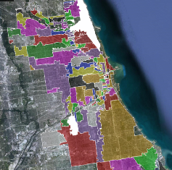
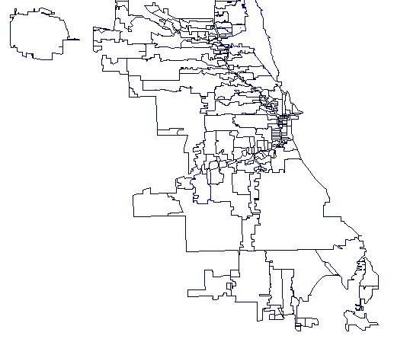
Processes/Data Involved in Real-Time Spatio-Temporal Rainfall Distribution Animation
Map-centric Web browser
Play the movie in the browser
Click a button
Animate
Streaming Fetcher (NEXRAD)
Polygon-based Spatial Transformation
(Iteratively calculate rainfall rate for each polygon in the input KML file)
Output KML File Stream
(each frame is a color-coded sewershed map at one time step)
Workflow
Read from the output KML stream and to
auto-generate a time-aware KML file
using last x frames
Triggers
Output KML stream in the repository
External Fetcher
NEXRAD

Slide 25
Challenge 2: Promoting Community Participation and Sharing by Providing Provenance-Aware “virtual sensors”

Slide 26
Provenance and OPM
Provenance:
Traditionally: from the French provenir, "to come from", means the origin, or the source of something, or the history of the ownership or location of an object (source: wikipedia)
In eScience/Sensor Web context
A description of how the digital object was derived
Causal relationships (generated by, derived from, etc.)
Fragments of Meta-data
Can be abstractly defined as a directed acyclic graph (DAG).
Open Provenance Model (OPM)
A draft standard for provenance
http://twiki.ipaw.info/bin/view/Challenge/OPM
Currently under community review and is evolving

Slide 27
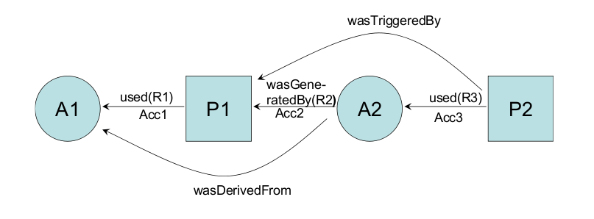
OPM: A Graphical Representation
Artifacts: things that are produced or used by processes (A1 and A2),
Processes: actions that are performed using or producing artifacts(P1 and P2)
Causal relationships: used, wasGeneratedBy etc. (R1, R2, and R3)
See: Open Provenance Model Vocabulary Specification 6 October 2010
http://open-biomed.sourceforge.net/opmv/ns.html

Slide 28
Why OPM?
Provenance was previously closely tied to specific workflow frameworks, which creates interoperability challenges among different workflow systems.
OPM provides an application- and domain-neutral way of describing data and process provenance.
In our Virtual Sensor system, we have computation and processes that are not just related to workflows
User Interaction (User Generated Virtual Sensors)
Standalone Java Daemon process (an external streaming data fetcher)
OPM enables us to do provenance mashup across all system layers

Slide 29
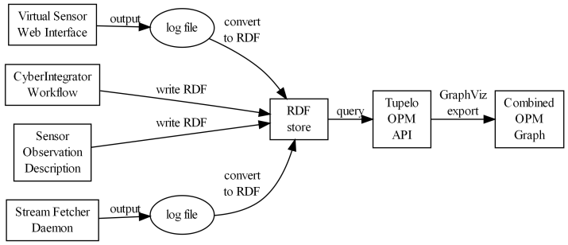
End-to-End OPM Provenance Mashup
Uses OPM vocabulary to write RDF (Resource Description Framework) statements about the provenance information across system layers
“log file to RDF conversion” can be eliminated if all system layers implement OPM-compliant provenance recording (our latest implementation has done that.)
RDF triple: Subject-Predicate-Object
URI(Uniform Resource identifiers) for all contents

Slide 30
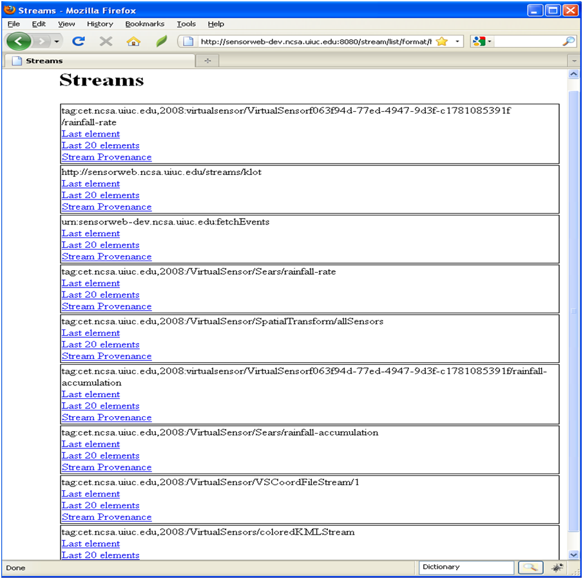
Provenance-Aware Virtual Sensors Published on the Web
Click to see the Provenance
Graph for a stream

Slide 31
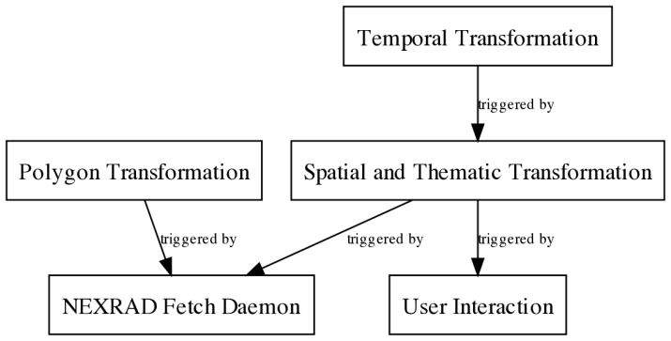
Provenance “Mash-up” Results (1)
SWE2010
Multiple granularity provenance graph can be generated
Overall Virtual Sensor OPM Provenance Graph Mashup Result with Minimum Details on Individual Process

Slide 32
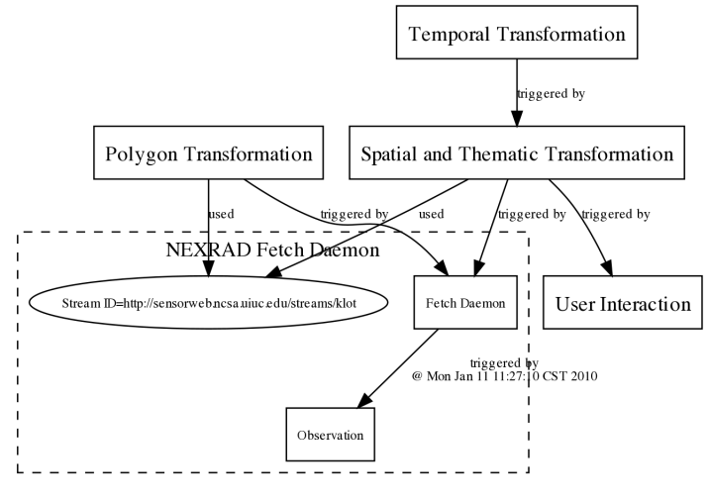
Provenance “Mash-up” Results (2)
SWE2010
OPM Graph with Details on NEXRAD Data Fetcher Daemon Process

Slide 33
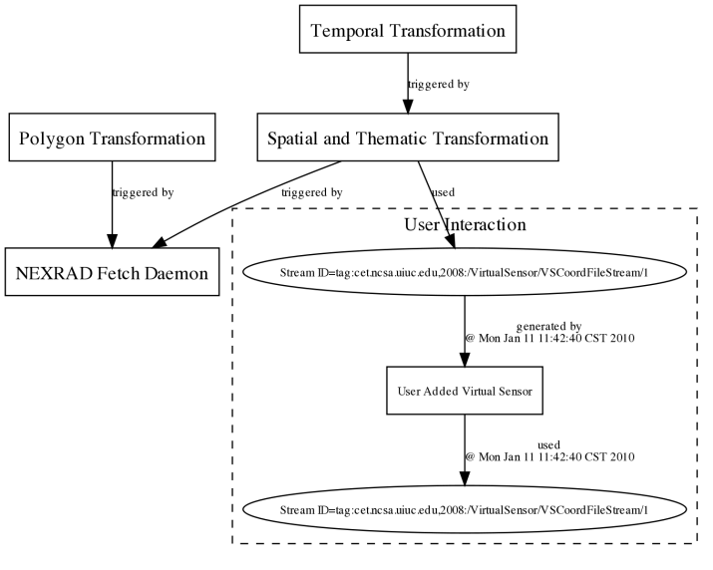
Provenance “Mash-up” Results (3)
SWE2010
OPM Graph with Details on User Interaction Process

Slide 34
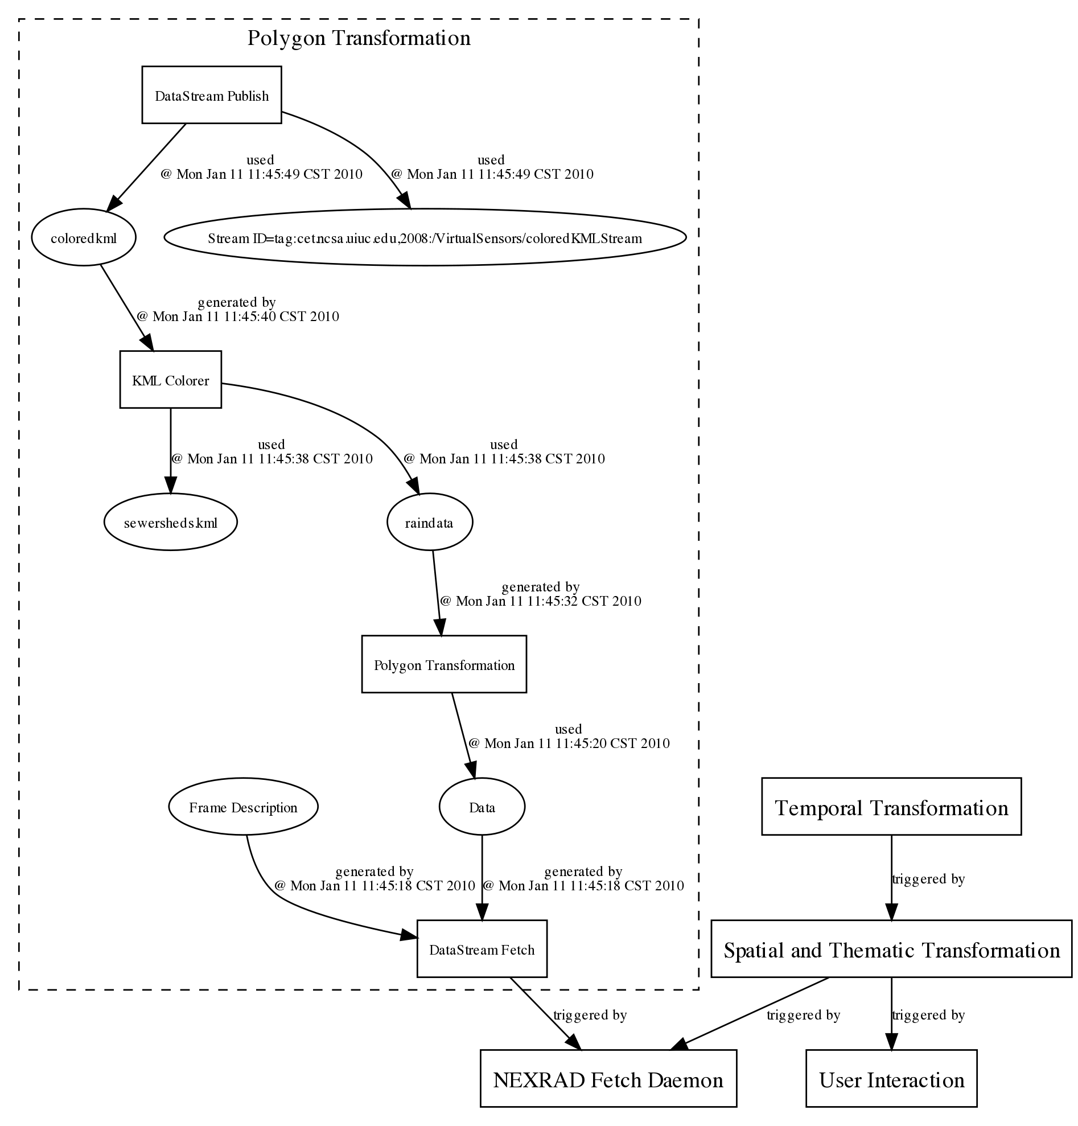
Provenance “Mash-up” Results (4)
SWE2010
OPM Graph with Details on Polygon Transformation Process for Polygon-based Virtual Rainfall Sensor

Slide 35
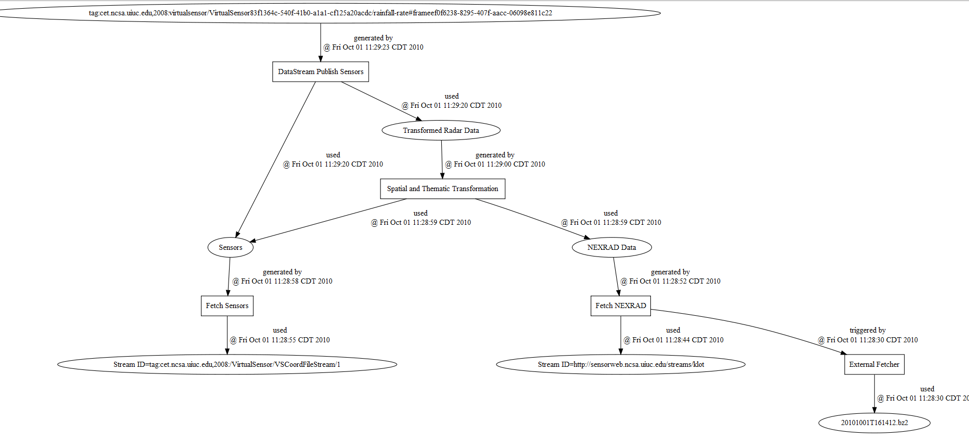
Live “Real-Time” Provenance Mashup
http://sensorweb-demo.ncsa.uiuc.edu

Slide 36
An Extended Virtual Sensor System
Virtual Sensor Knowledge Streams
Model-based Transformation
Virtual Sensor Information Streams
Virtual Sensor/Sensor
Stream publishing
Virtual Sensor Data Streams
Provenance Mashup across Layers
Streams: 01010101010101010101010101010101 ……..
Observational Sensor Networks
Dagstuhl Seminar 2010

Slide 37
Current Active New Projects: Digital Urban Informatics (1)
Funded by Microsoft Research: three objectives
1. Virtual Sensors-based Geospatial Visual Analytics (including citizen sensing: tweeter feeds)
3. Interoperability: Provenance Mashup in and outside of the Cloud
2. Event-triggered On-demand Computation and Data Synchronization in the Cloud

Slide 38


Digital Urban Informatics (2)
Provenance Record Table
|Subject|Predicates|Object|
Worker Role
(message content-based instantiation)
Shared Job Queue
(model run, file synchronization/transfer etc.)
Web Role
1…N Workers
Blob Storage (input, output, model)
*Multi-threaded Parallelization
On multi-core Nodes
*Multi-node Parallelization
*Use Case: groundwater
Sustainability study in Arizona
: large ensemble runs
:ModflowOnAzure
Scientific Workflow (e.g., Trident),
GUI-based Pre-Processing Software (e.g.: Visual Modflow)
Desktop or Servers or Mobile
Event-triggered Computation and Data Synchronization in the Cloud

Slide 39
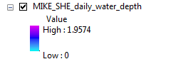
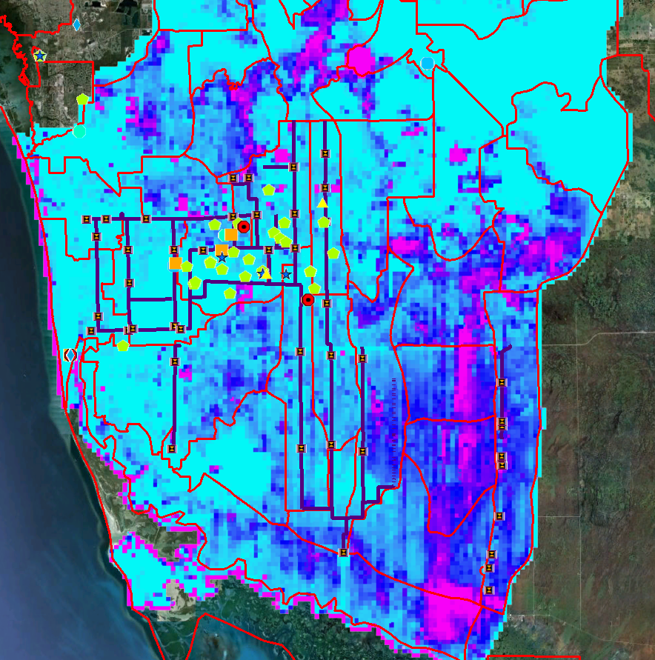
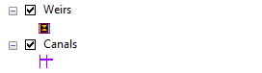
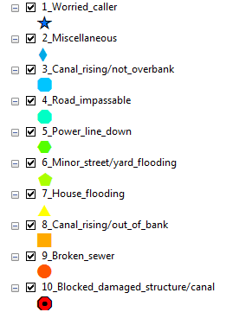
Digital Urban Informatics (3)
Simulated data
Citizen Sensing in Urban flooding: South Florida
Measured data
Citizen-sensing data

Slide 40
Conclusions and Future Work
An Example Implementation of Virtual Environmental Observatories has been presented
User-generated point and polygon-based virtual sensors are currently supported for radar-based virtual rainfall sensors
OPM-based Provenance mashup across all system layers for a Virtual Sensor system has been implemented
Provenance of heterogeneous processes (workflows, Java daemons and user interface interactions) has be integrated: one of the first kind
Provenance-aware Virtual Sensors are published on the web on-the-fly
Useful for validation and verification of the virtual sensor streams
Ongoing and Future Work
Microsoft Research-funded “Digital Urban Informatics” framework harmonizes both data-driven and physics model-based Cyber Science and engineering
Provenance mashup across a hybrid Cyberinfrastructure platform consisting of local systems (private cloud, local supercomputers) and public Cloud computing platforms (such as Microsoft Azure)
Integrating citizen sensing and multiple models-based Virtual sensors for decision support

Slide 41
Acknowledgments
R&D Team and Collaborators
NCSA: Yong Liu, Joe Futrelle, Sam Cornwell, Ron Searl, Luigi Marini, Rob Kooper, Terry McLaren
Department of Civil and Environmental Engineering: Barbara Minsker
Department of Computer Science: Tarek Abdelzaher
Department of Geography: Murugesu Sivapalan
USGS Illinois Water Science Center: David Fazio, Tom Over, Audrey Ishii
Computational Center for Nanotechnology Innovations, Rensselaer Polytechnic Institute: James Myers
Amazon: Alejandro Rodriguez
Microsoft Research: Yan Xu, Dean Guo, Arjmand Samuel, Wenming Ye

Slide 42
Funding Support
Funding Support
NCSA/Office of Naval Research TRECC Digital Synthesis Framework for Virtual Observatory Project
Illinois IACAT (Institute of Advanced Computing Applications and Technology) Project
AESIS (Adaptive Environmental Sensing and Information Systems) Initiative at NCSA/UIUC
NSF WATERS Network Project Planning Office
Microsoft Research

Slide 43
References
Liu, Yong, A. Rodrigues, R. Kooper, J. Myers, (2010). A Provenance-Aware Virtual Sensor System using the Open Provenance Model, Sensor Web Enablement workshop 2010, The 2010 International Symposium on Collaborative Technologies and Systems , May 17-21, 2010, Chicago, IL
D.Hill, Liu, Yong et al. (2010), Using a Virtual Sensor System to Customize Environmental Data Products, Environmental Software and Modeling, Submitted
Liu,Yong, D. Hill, L. Marini, R. Kooper, A. Rodriguez, J. Myers (2009)."Web 2.0 Geospatial Visual Analytics for Improved Urban Flooding Situational Awareness and Assessment", ACM GIS '09 , November 4-6, 2009. Seattle, WA, USA
Alejandro Rodriguez, Robert E. McGrath, Yong Liu and James D. Myers, "Semantic Management of Streaming Data", 2nd International Workshop on Semantic Sensor Networks at the International Semantic Web Conference, Washington, DC, October 25-29, 2009
Liu, Yong, X. Wu, D. Hill, A. Rodrigues, L. Marini, R. Kooper, J. Myers, B. Minsker (2009). A New Framework for On-Demand Virtualization, Repurposing and Fusion of Heterogeneous Sensors , Sensor Web Enablement workshop 2009, The 2009 International Symposium on Collaborative Technologies and Systems , May 18-22, 2009, Baltimore, MD
Liu,Yong, D. J. Hill, A. Rodriguez, L. Marini, R. Kooper, J. Futrelle, B. Minsker, J. D. Myers (2008), Near-Real-Time Precipitation Virtual Sensor based on NEXRAD Data, ACM GIS 08, November 5-7, 2008, Irvine, CA, USA.
Liu,Yong, D. J. Hill, T. Abdelzaher , J. Heo, J. Choi, B. Minsker, D. Fazio (2008), Virtual Sensor-Powered Spatiotemporal Aggregation and Transformation: A Case Study Analyzing Near-Real-Time NEXRAD and Precipitation Gage Data in a Digital Watershed, In Proceedings of the Environmental Information Management Conference 2008, September 10 - 11, 2008, University of New Mexico, Albuquerque, NM.
For more Information: visit http://www.ncsa.illinois.edu/~yongliu/

